Slide 1
Chapter 7
Lesson 1
Air and Weather
&
Lesson 4
Climate
Pages 170-175, 190-195

Slide 2
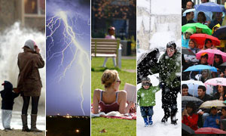
Please Do Now!
In the margin of your paper, list three ways the weather affects your life.
Share your examples with your partner.

Slide 3
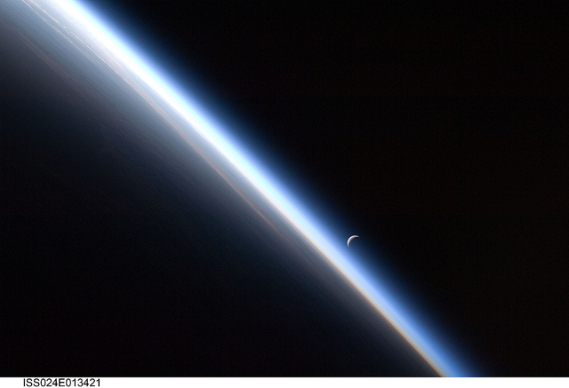
1. The blanket of air surrounding Earth is called the atmosphere.

Slide 4
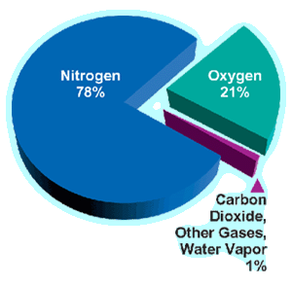
2. The atmosphere is made up mostly of nitrogen and oxygen.

Slide 5
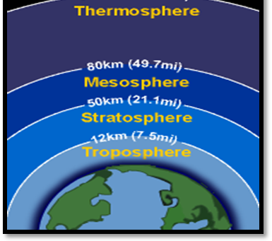
3. The four layers of Earth’s atmosphere, from lowest to highest, are troposphere, stratosphere, mesosphere, and thermosphere.

Slide 6
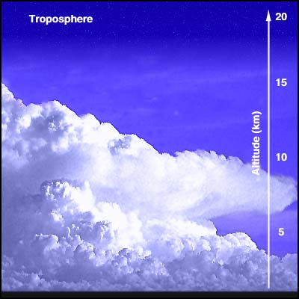
All of Earth’s life exists in the troposphere. It is also where all of Earth’s weather takes place.

Slide 7
4. The condition of the atmosphere at a given time and place is called weather. *The four properties of weather are temperature, humidity, air pressure, and precipitation.

Slide 8
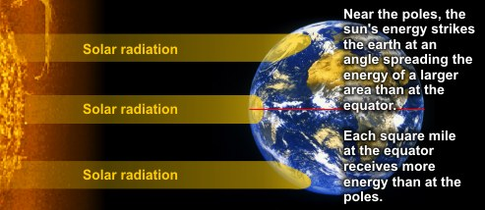
5. When you measure how hot or cold something is, you measure its temperature. Three factors that affect air temperature include time of day or night, the season and closeness to oceans.

Slide 9
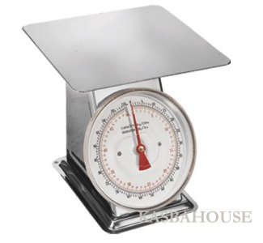
What Do You Think?
Do you think air has weight to it? What makes you think that?
Share your answer with a partner.

Slide 10
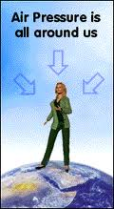
6. Air has weight to it. The force of air pushing on an area is called air pressure.

Slide 11
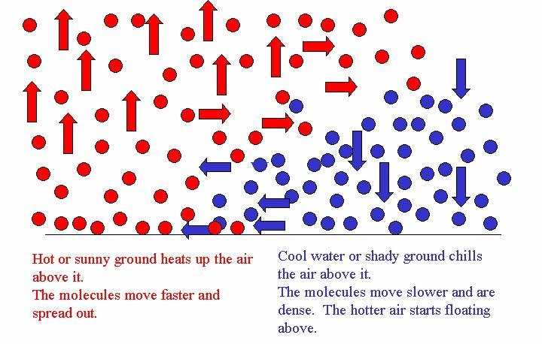
7. Warm air particles are less dense or packed together, than cold air.

Slide 12
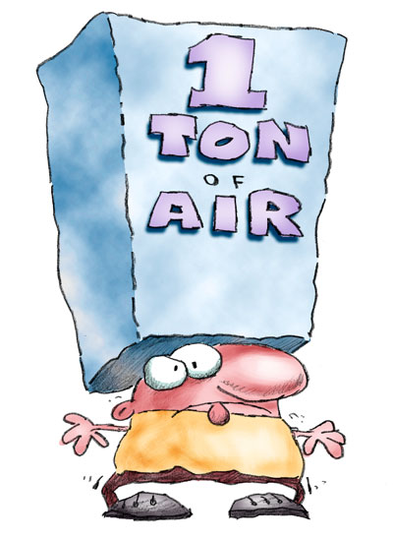
8. As air cools, the air pressure increases.

Slide 13
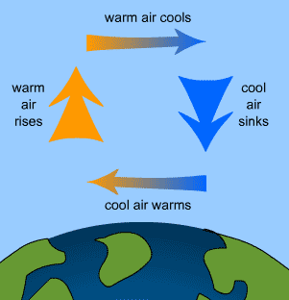
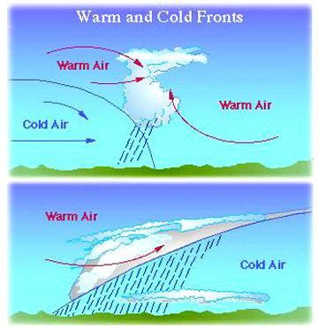
Cool air has higher air pressure than warmer air. (Cooler air weighs more than warmer air.) Air moves from an area of higher pressure to lower pressure.

Slide 14
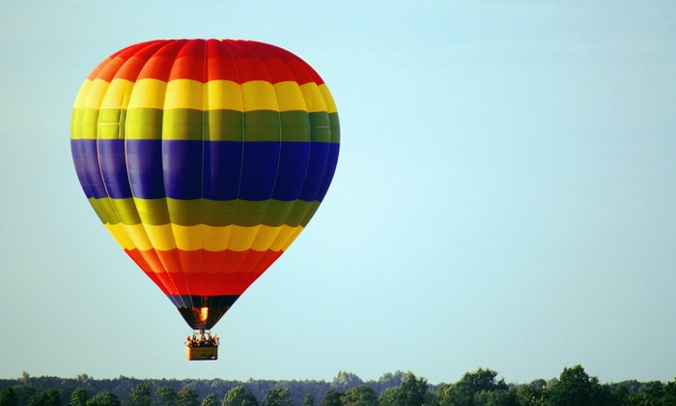

Slide 15
Cool air has higher air pressure than warmer air. (Cooler air weighs more than warmer air.) Air moves from an area of higher pressure to lower pressure.

Slide 16

9. Moving air is called wind.

Slide 17
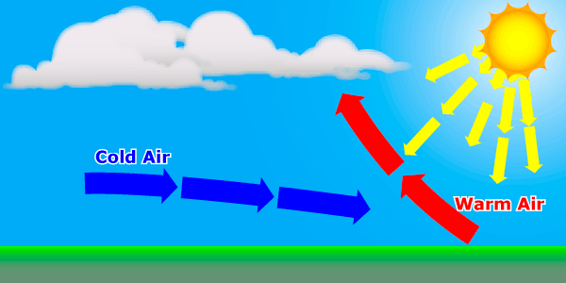
10. Air moves when the Sun’s energy heats the air.

Slide 18
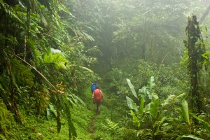
11. A measure of the amount of moisture in the air is humidity.

Slide 19
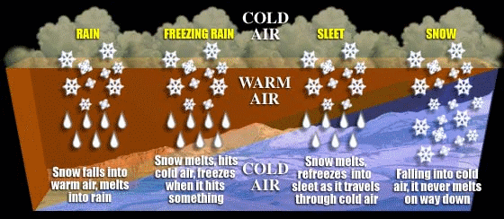
12. Any form of water that falls from the clouds is precipitation. The term includes rain, snow, sleet, and hail.

Slide 20
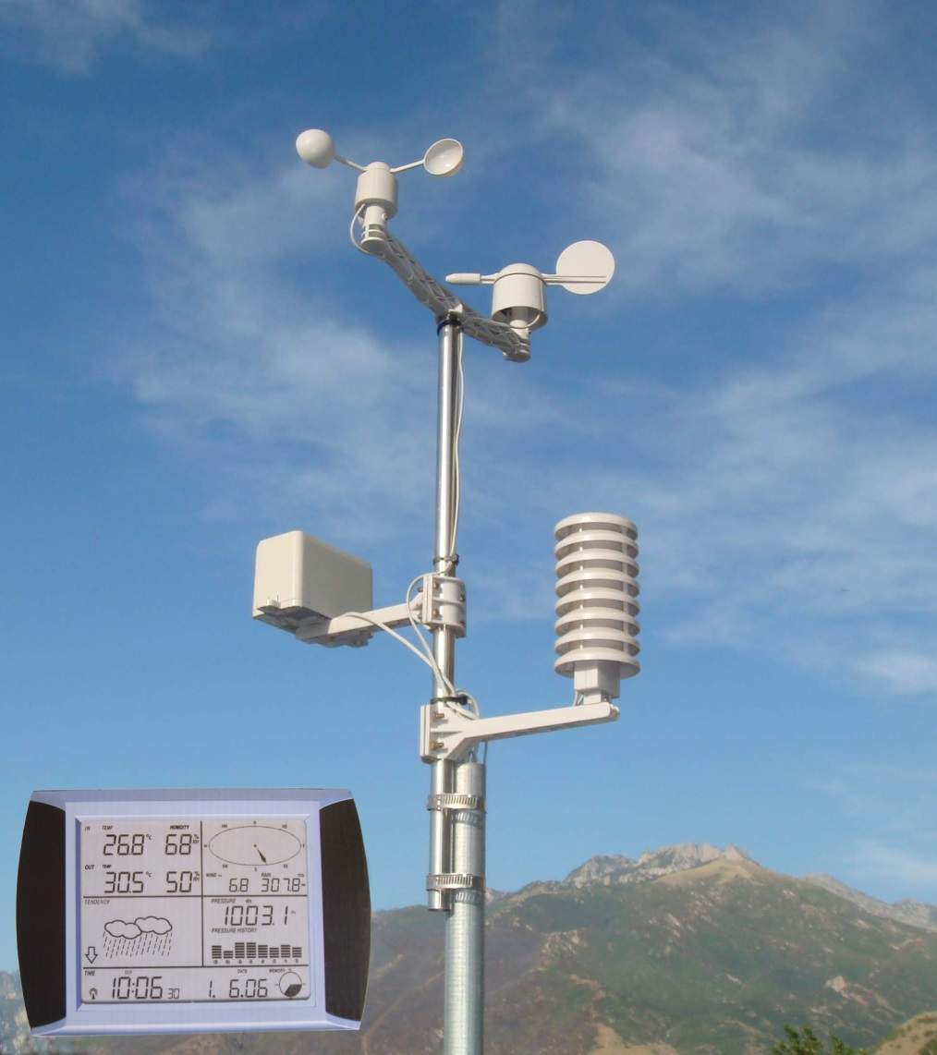
13. Scientists collect data from a weather station.

Slide 21
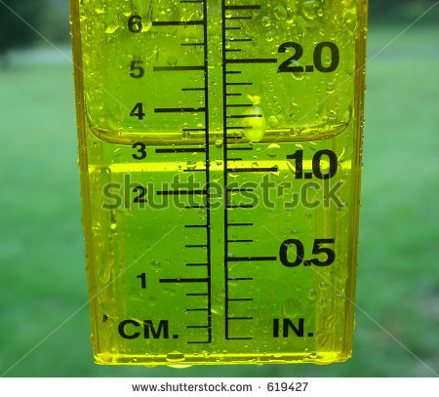
14. To measure rainfall, scientists collect rain in a tube called a rain gauge.

Slide 22
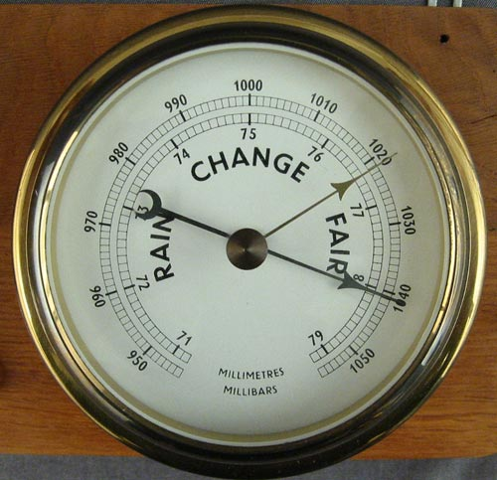
15. A tool used to measure air pressure is called a barometer.

Slide 23
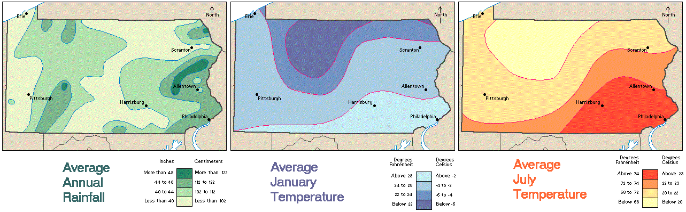
16. Weather changes day to day, even hour to hour. But climate is the pattern of weather in a place
over a long period of time.

Slide 24
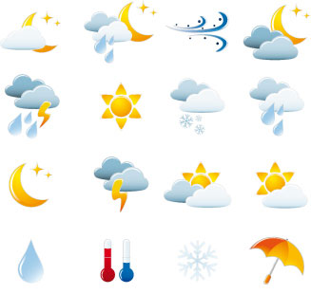
17. Pennsylvania has a temperate climate. It doesn’t get extremely hot or cold.

Slide 25
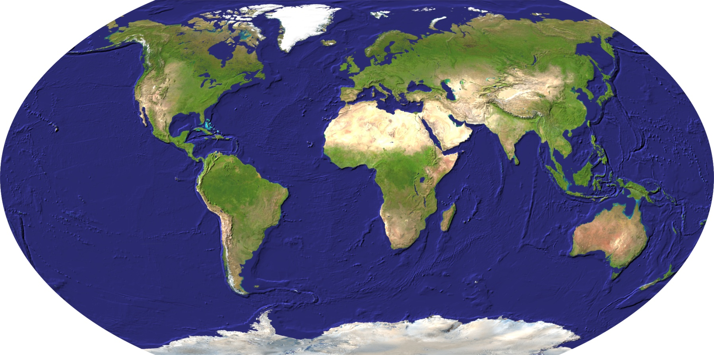
18. Pennsylvania’s location on Earth affects its climate.

Slide 26
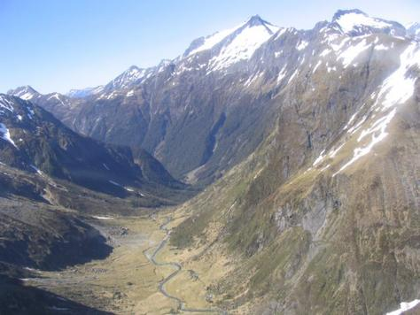
19. Elevation also affects the climate in an area.

Slide 27
Scrabble Summary
Create a Scrabble Summary to describe what you know about weather. Use the example below as a guide.
WEATHER

